Slide 1
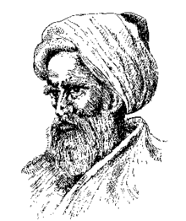
Ibn al-Haytham
Notes:
# Name Ibn al-Haytham # Textbook Knight, College Physics: A Strategic Approach, 2nd Edition, Chapter 18 Knight, Physics for Scientists and Engineers: A Strategic Approach with Modern Physics, 3rd Edition, Chapter 13 # Contributors # Description Ibn al-Haytham (c.965 - c.1040 AD), aka Alhazen, was a physicist as well as a mathematician and astronomer during the Islamic Golden Age. Alhazen is most known for his contributions to optics and the scientific method. Going against the emission theory of Euclid and Ptolemy and the intromission theory of Aristotle, Ibn al-Haytham theorized that we see objects because the eyes receive the rays of light that reflect off an object (Wikipedia). His most famous work, Kitāb al-manāẓir, described this phenomenon and included details about reflection and refraction. Ibn al-Haytham was keen on using experimentation and mathematical reasoning to support his theories (Lorch). Alhazen also had an understanding that to prove a hypothesis, one must perform experiments of have numerical evidence. Through this practice, he showed an understanding of the scientific method many centuries before it was established. In addition to sight and the scientific method, Alhazen investigated the rainbow, moonlight, celestial physics, motion of the body, and more (Wikipedia). # Sources Lorch, R. (2017, February 01). Ibn al-Haytham. Retrieved February 20, 2018, from https://www.britannica.com/biography/Ibn-al-Haytham Ibn al-Haytham. (2018, February 20). Retrieved February 20, 2018, from https://en.wikipedia.org/wiki/Ibn_al-Haytham#Scientific_method # Photo https://upload.wikimedia.org/wikipedia/commons/thumb/6/63/Alhazen%2C_the_Persian.gif/220px-Alhazen%2C_the_Persian.gif

